Slide 1
Aviation_data
PRESENTATION

Slide 2
Safest Aircraft Models for Commercial and Private Enterprises
By:
FLOYED MUCHIRI
DSC FULLTIME REMOTE

Slide 3
BUSINESS PROBLEM
Expanding into the aviation industry
Objective:
Determine the safest aircraft models for commercial and private use

Slide 4
Data Overview
Dataset: Aviation_Data.csv from NTSA
90,348 entries, 31 columns
Key Columns:
Event ID, Investigation Type, Accident Number, etc.
Data Cleaning:
Dropped duplicates, handled missing values
Separated key focus I.e Airplane and Helicopter

Slide 5
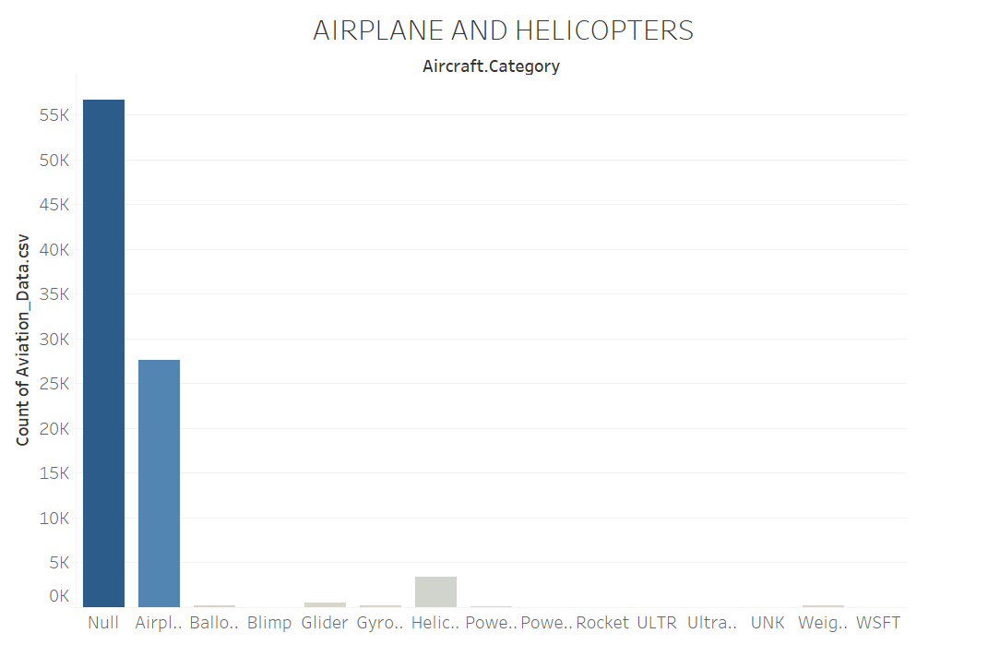
AirCraft categories
AIRCRAFT CATEGORIES
Airplane 21977
Helicopter 2826
Glider 417
Weight-Shift 160
Gyrocraft 153
Balloon 113
Powered Parachute 88
Ultralight 23
WSFT 9
Rocket 1
Powered-Lift 1
ULTR 1
Blimp 1

Slide 6
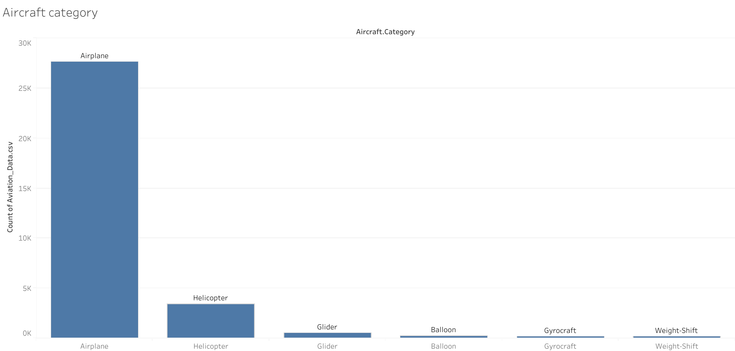

Slide 7
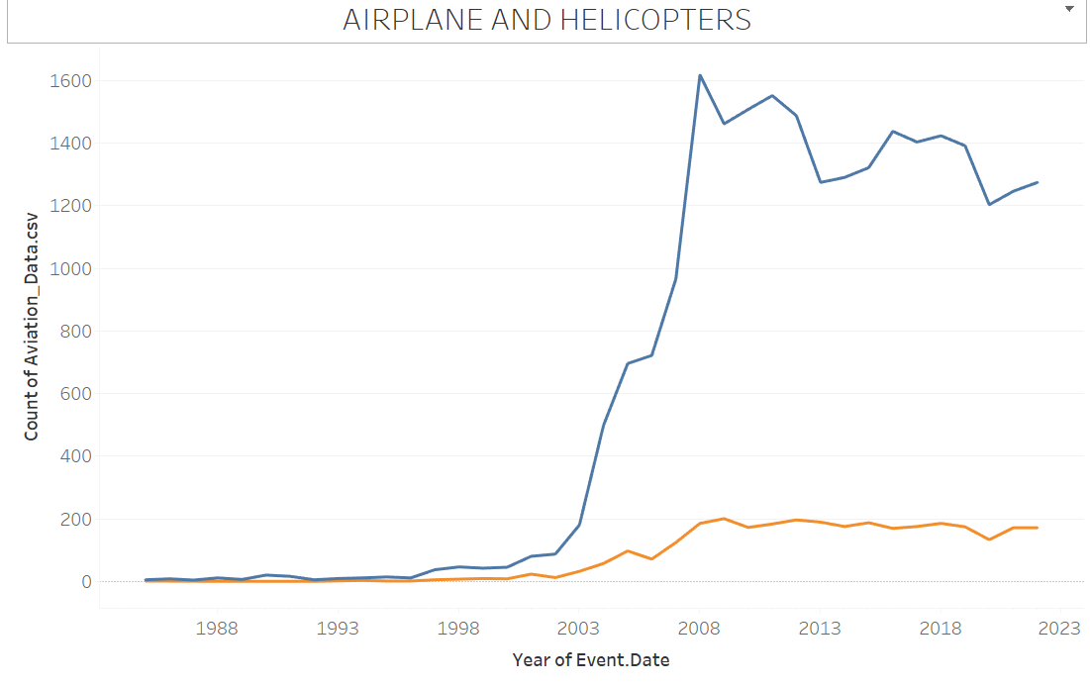
Airplane and Helicopter Trend

Slide 8
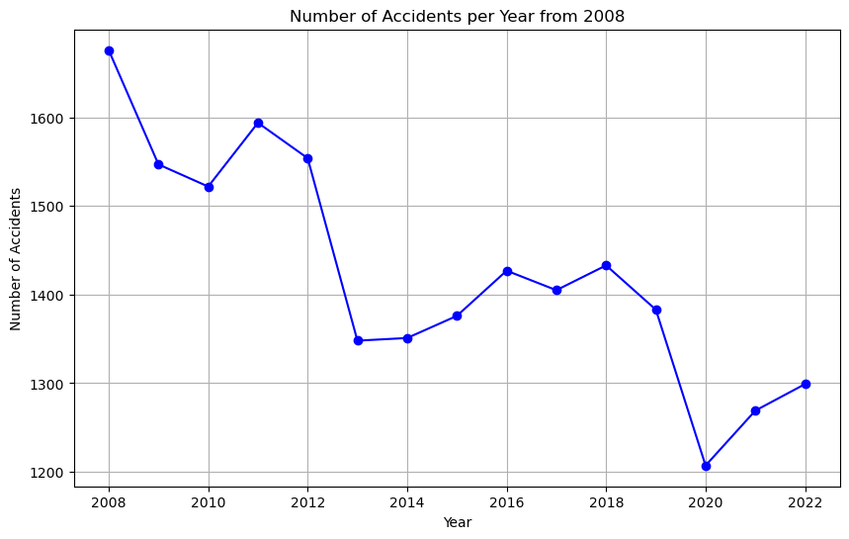
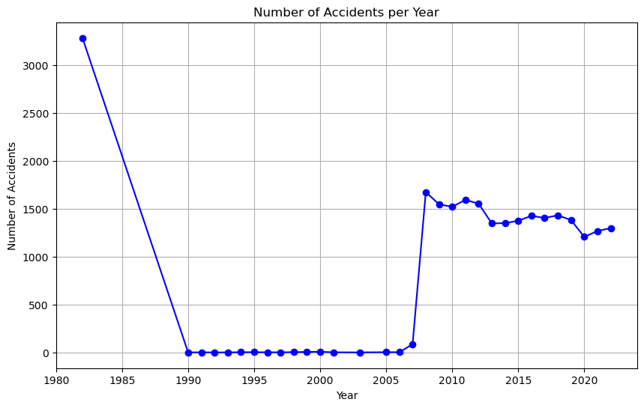
Methodology
Used consistent data from 2008

Slide 9
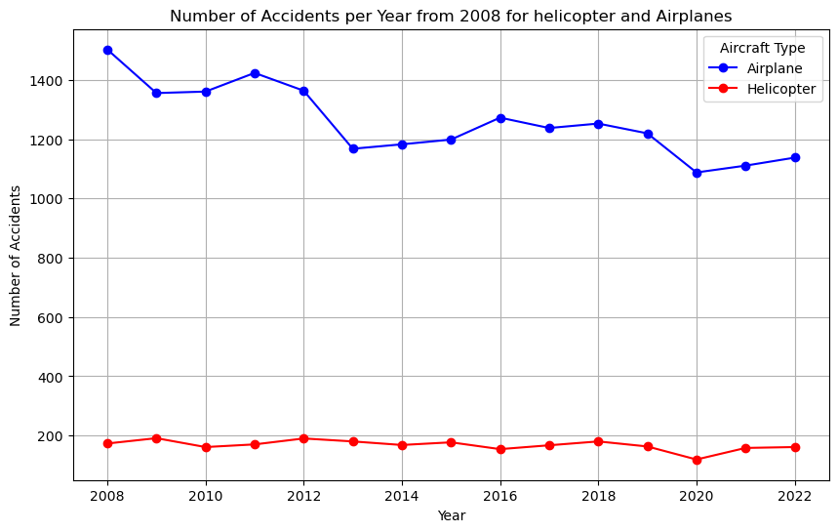
Methodology Cont’d
Separated Airplane and Helicopter Aircrafts
Weighted factors for safety score
Calculation:
Accidents per model
Fatalities, serious injuries, minor injuries
Aircraft damage
Safety score formula

Slide 10
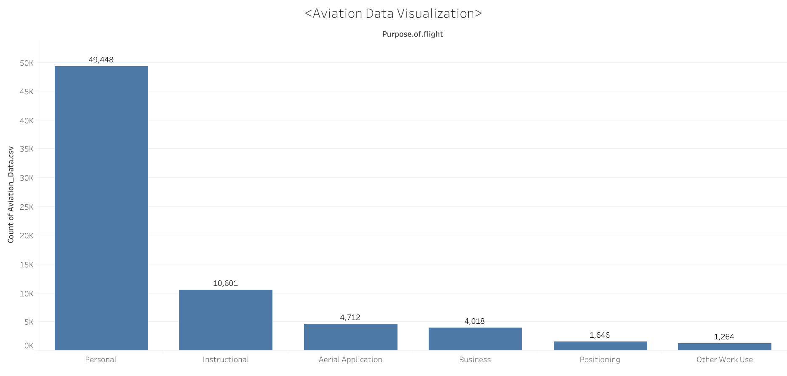

Slide 11
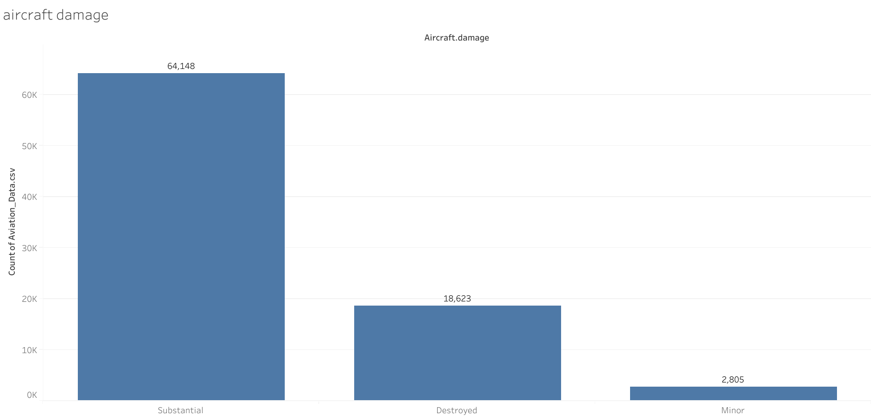

Slide 12
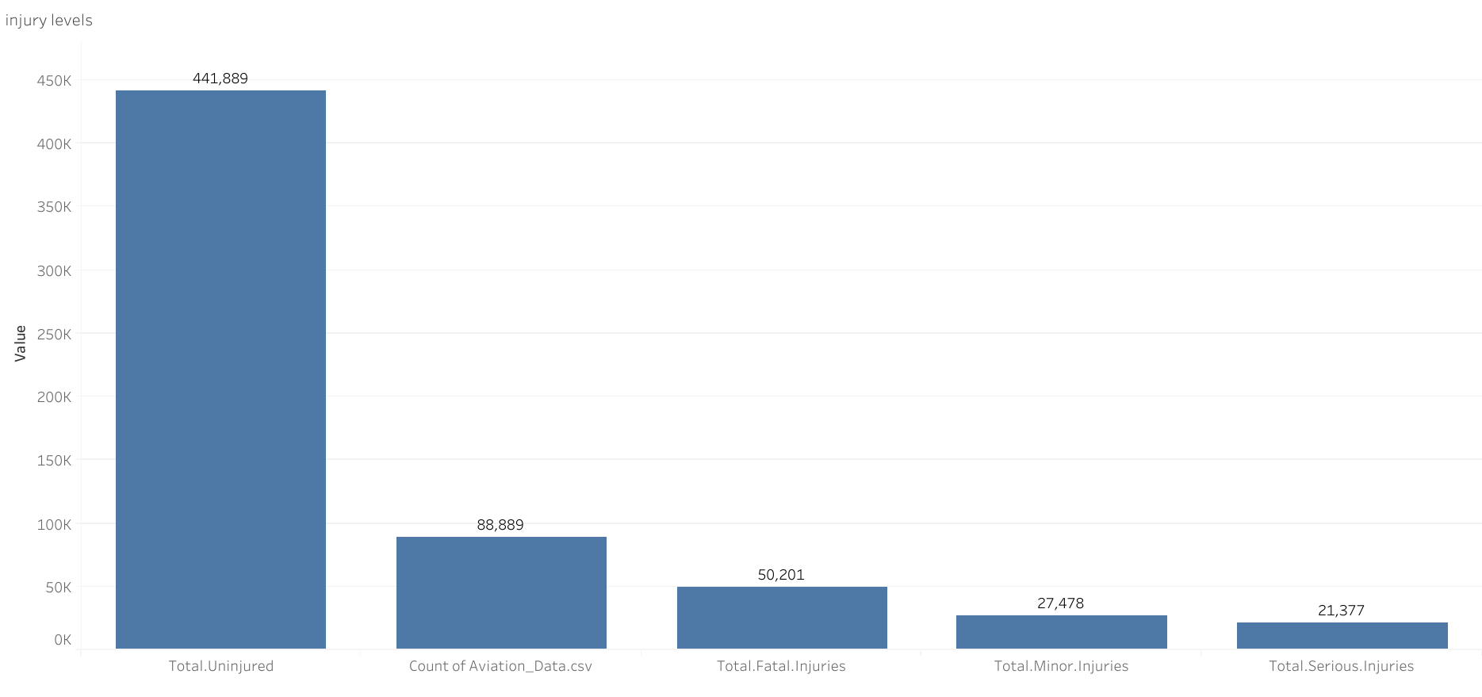

Slide 13
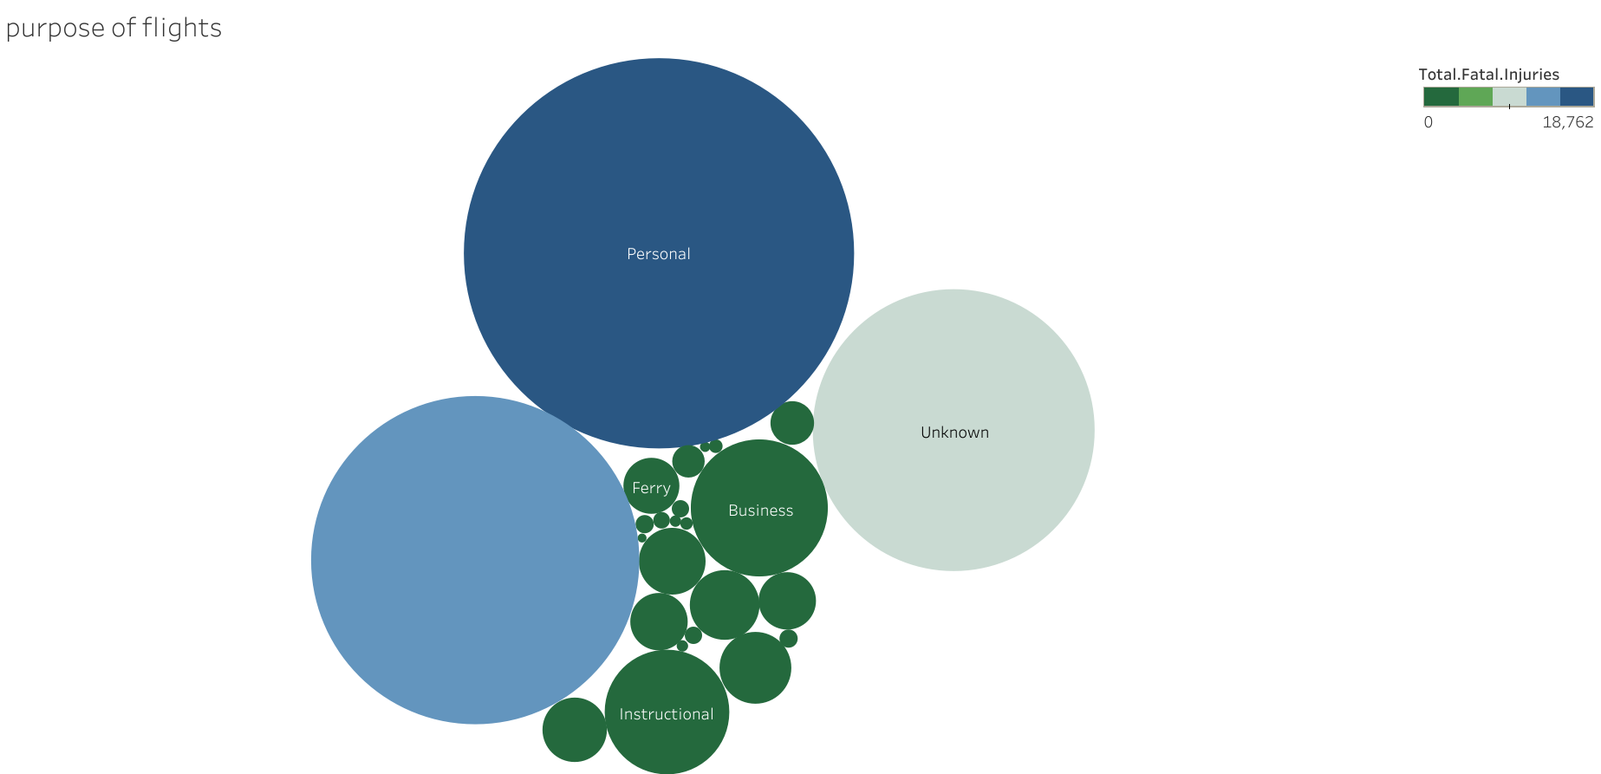

Slide 14
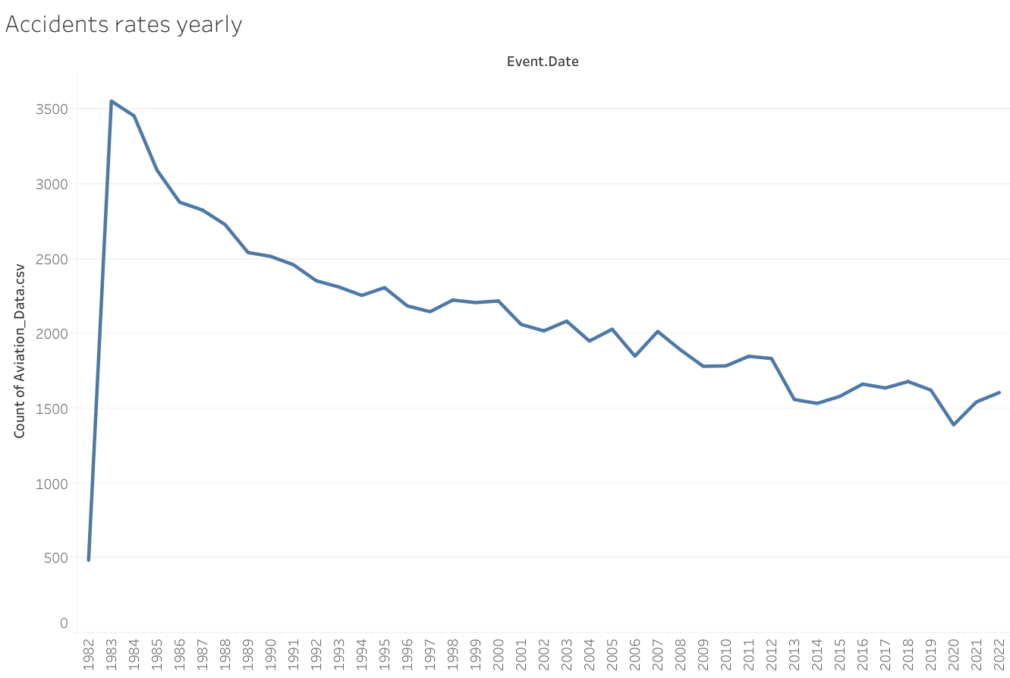

Slide 15
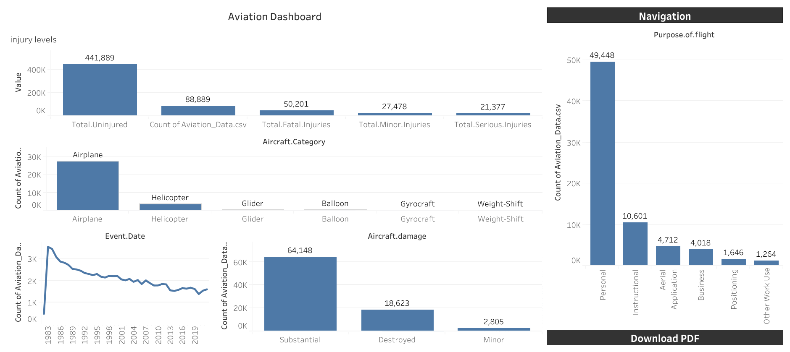

Slide 16
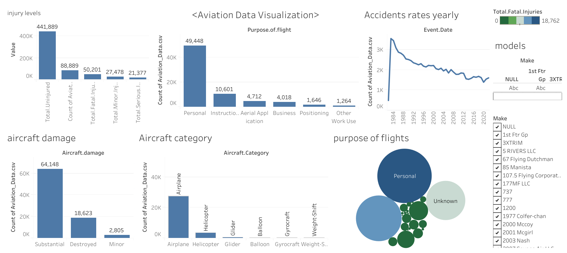

Slide 17
Safety Score Calculation
Factors considered:
weight fatalities = 0.4
Weight serious injuries = 0.3
Weight minor injuries = 0.2
Weight aircraft damage = 0.1
Injury Severity:
weight injury severity fatal = 0.4
Weight injury severity serious = 0.3
Weight injury severity minor = 0.2
Weight injury severity non fatal = 0.1
Formula: (weights * factors) / total accidents

Slide 18
Results - Airplanes
Table of safety scores for each model – top 5
 | Model | Safety Score | Make
1 | 787 | 0.03 | BOEING
2 | STALKER | 0.03 | LOCKHEED
3 | HEAVISIDE2 | 0.03 | KITTY HAWK
4 | JAS4-2 | 0.03 | JOBY AERO INC
5 | J3F-50 | 0.03 | PIPER

Slide 19
Results - Helicopters
Table of safety scores for each model – top 5
 | Model | Safety Score | Make
0 | APT70 | 0.03 | BELL
1 | MATRICE | 0.06 | DJI
2 | 400 | 0.07 | SAFARI
3 | S-58ET | 0.07 | SIKORSKY
4 | S-58HT | 0.07 | SIKORSKY

Slide 20
Recommendations
Based on safety scores and accident history
Suggested Models: Airplane
BOEING 787,
LOCKHEED Stalker,
KITTY HAWK HEAVISIDE2
Suggested models: Helicopter
Bell APT70
DJI MATRICE
Safari 400
Considerations for commercial and private use:
Airplane for commercial- Bristell ELSA
Airplane for private use – piper J3F-50
Helicopter for commercial use – Enstrom F28F
Helicopter for private use – Safari 400

Slide 21
Q&A

Slide 22
THANK YOU

